Slide 1
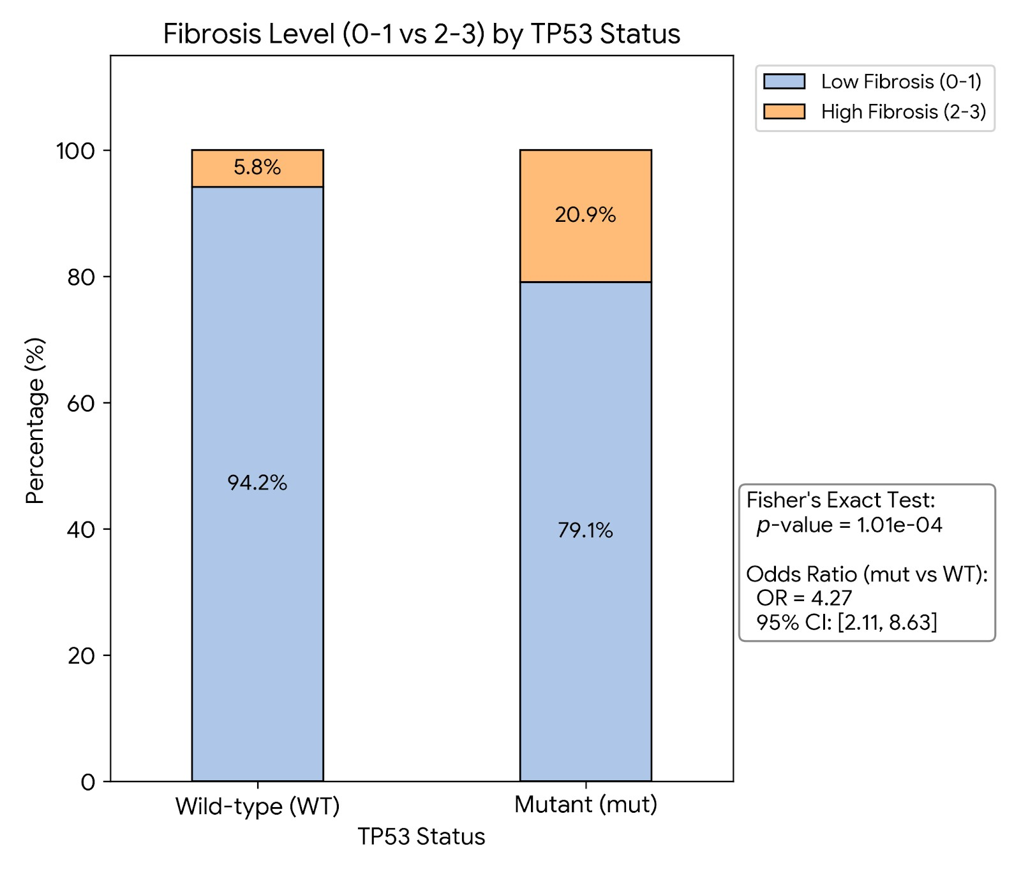
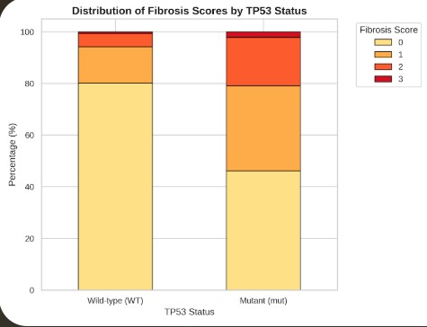

Slide 2
AML-TP53 fibrosis DSP
五個假說與
分析設計整理
Bulk-like DE 做為起點；
DSP 的價值在於把 region、segment 與 interaction 轉成預先定義的對比分析。
Fibrosis (F vs NF) × Region (INT vs PARA)
核心訊息
NF_INT
NF_PARA
先定義 biological questions → 對應 model/contrast → 產生 DE table 與 ranked list → 再接 volcano、heatmap、GSEA/ORA。
F_INT
F_PARA
袁章祖 2026/07/06
01

Slide 3
AML-TP53 fibrosis DSP
為什麼 DSP 分析不是只有 bulk-like DE？
Bulk-like DE
DSP 多了 spatial design
本研究的重點
一個樣本一個 profile
Expression ~ DiseaseGroup
回答：兩組整體平均是否不同
同一 case 內有 region / AOI / segment
可以測試 region、segment 與 group interaction
Fibrosis-associated change 是否集中在 paratrabecular niche？
不同 compartment 是否帶有不同訊號？
標準流程的核心：把預先設計的 region / segment 轉成可解釋的對比。
H0：組成總覽
H1：整體差異
H2：Region 差異
H3：region x fibrosis Interaction
H4：Compartment 差異
02

Slide 4
AML-TP53 fibrosis DSP
實驗設計如何映射到分析物件
Case
Region
Segment
AOI replicate
Fibrosis
A1, A2
CD45-bright
immune-enriched
Intertrabecular
每個 Case × Region × Segment
設計上有 AOI 重覆
但不是完全獨立 cases
CD68+
macrophage/histiocyte
Nonfibrotic
B1
Paratrabecular
Leftover
mixed tumor/stromal
分析警語
目前 primary set 的 nonfibrotic 只有 B1；DE / interaction 可產生 ranked list 與假說，但 p value 需視為 descriptive / hypothesis-generating。
03

Slide 5
AML-TP53 fibrosis DSP
五個 planned hypotheses：從 composition 到 interaction
H0
H1
H2
H3
H4
Composition
Overall fibrosis
Region main effect
Fibrosis × Region
Compartment-specific fibrosis
compartment proportion 是否不同？
bulk-like baseline fibrosis effect
PARA vs INT 是否不同？
fibrosis effect 是否特別在 PARA？
CD45/CD68/Leftover 各自 fibrosis effect
Hierarchy for reporting
Primary：H3 interaction | Major biology：H4 | Supporting：H2 | Composition check：H0 | Overview：H1
04

Slide 6
AML-TP53 fibrosis DSP
H0：Compartment abundance / composition
生物問題
AOI composition concept
Fibrosis 或 paratrabecular niche 是否造成 CD45-bright、CD68+、Leftover compartment 比例改變？
NF_INT
CD45
Leftover
Parameter handling
NF_PARA
CD45
CD68
Leftover
FibrosisGroup：加入分析。
Region：加入分析。
SegmentLabel：作為 abundance outcome 類別，不是 adjustment。
Case/AOI：目前 descriptive；加 case 後再做更正式模型。
F_INT
CD45
CD68
Leftover
F_PARA
CD68
Leftover
Purpose：分辨「某 compartment 變多」vs「同一 compartment 內 expression state 改變」。
05

Slide 7
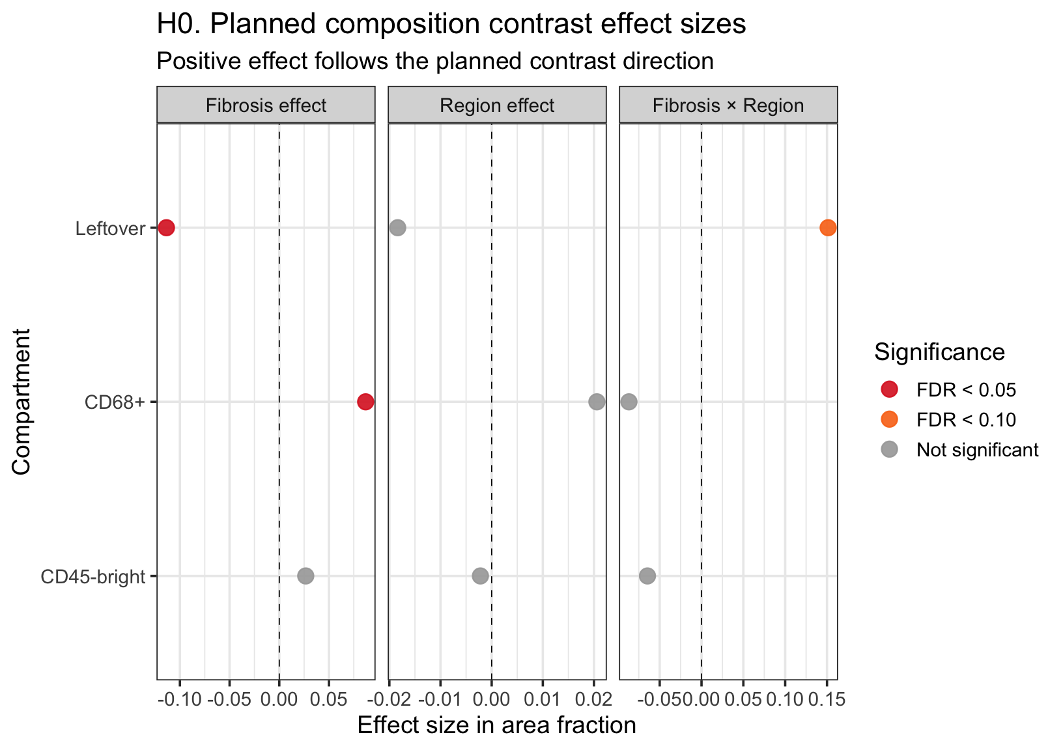
Fibrosis vs non-fibrosis
More macrophage
Less leftover
Paratrabecular vs intertrabecular
No difference
Fibrosis x region
* Fibrosis x para: more macrophage

Slide 8
AML-TP53 fibrosis DSP
H1 與 H4：Fibrosis effect 的兩種層次
H1. Overall fibrosis main effect
H4. Compartment-specific fibrosis effect
所有 primary segments 放在一起，先看 Fibrosis vs Nonfibrotic 的整體差異。
Region：baseline overview 中不特別處理。
Segment：baseline overview 中不分 compartment。
CD45-bright、CD68+、Leftover 各自做 Fibrosis vs Nonfibrotic。
Region：使用 region-balanced contrast。
Segment：分 compartment 分析，不混成 primary result。
H4 interpretation
0.5×(F_PARA + F_INT) − 0.5×(NF_PARA + NF_INT)
Which compartment carries fibrosis-associated signal?
If H4 is strong but H3 is weak, fibrosis effect is present but not region-specific.
06

Slide 9
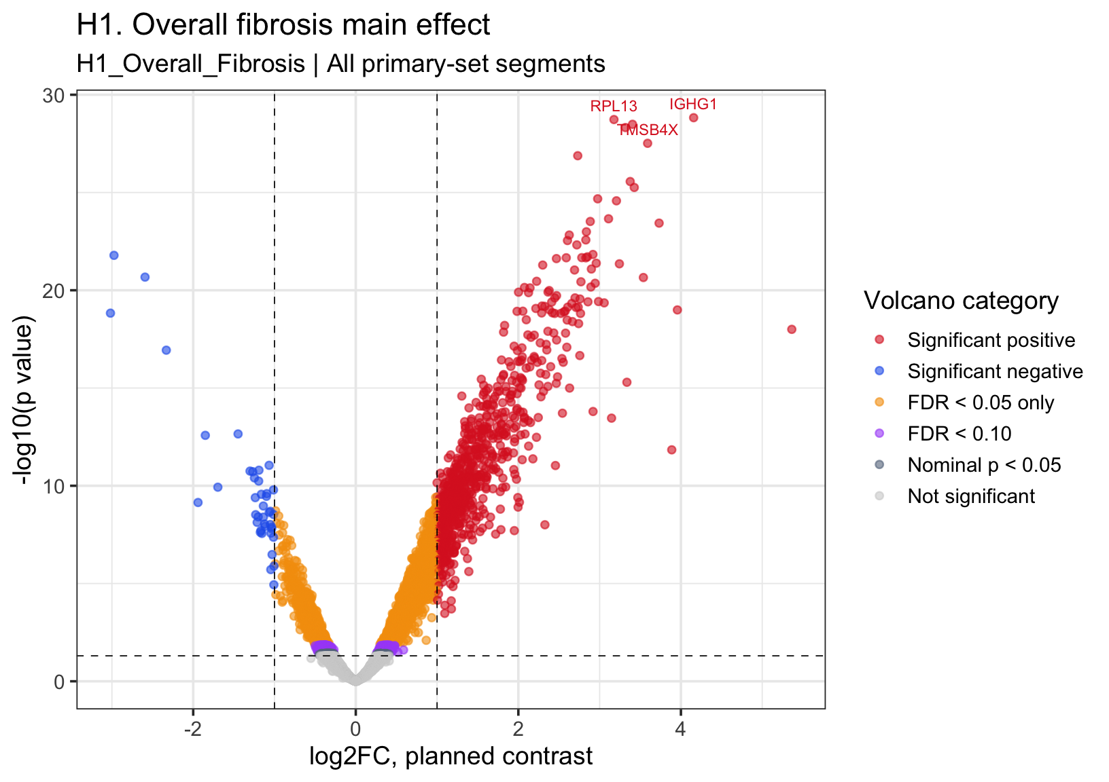
H1: Overall WTA: fibrosis vs non-fibrosis
TableBlock | TargetName | log2FC | ModeratedT | PValue | FDR | Direction | DirectionForTable | VolcanoCategory
Top negative-direction targets | AZU1 | -2.975 | -14.130 | 1.64e-22 | 1.53e-19 | Higher in Nonfibrotic | Negative contrast direction | Significant negative
Top negative-direction targets | PRTN3 | -2.593 | -13.460 | 2.13e-21 | 1.28e-18 | Higher in Nonfibrotic | Negative contrast direction | Significant negative
Top negative-direction targets | DEFA1B | -3.018 | -12.380 | 1.48e-19 | 4.15e-17 | Higher in Nonfibrotic | Negative contrast direction | Significant negative
Top negative-direction targets | ELANE | -2.331 | -11.300 | 1.16e-17 | 2.41e-15 | Higher in Nonfibrotic | Negative contrast direction | Significant negative
Top negative-direction targets | BIVM | -1.448 | -8.970 | 2.23e-13 | 1.87e-11 | Higher in Nonfibrotic | Negative contrast direction | Significant negative
Top negative-direction targets | CTSG | -1.851 | -8.932 | 2.64e-13 | 2.13e-11 | Higher in Nonfibrotic | Negative contrast direction | Significant negative
Top negative-direction targets | SPDYE2 | -1.066 | -8.113 | 9.00e-12 | 5.46e-10 | Higher in Nonfibrotic | Negative contrast direction | Significant negative
Top negative-direction targets | GJB2 | -1.191 | -7.980 | 1.60e-11 | 9.14e-10 | Higher in Nonfibrotic | Negative contrast direction | Significant negative
Top negative-direction targets | TMTC4 | -1.301 | -7.956 | 1.78e-11 | 1.01e-09 | Higher in Nonfibrotic | Negative contrast direction | Significant negative
Top negative-direction targets | UBXN11 | -1.268 | -7.939 | 1.90e-11 | 1.07e-09 | Higher in Nonfibrotic | Negative contrast direction | Significant negative
Top positive-direction targets | IGHG1 | 4.156 | 18.770 | 1.49e-29 | 1.73e-25 | Higher in Fibrosis | Positive contrast direction | Significant positive
Top positive-direction targets | RPL13 | 3.176 | 18.700 | 1.85e-29 | 1.73e-25 | Higher in Fibrosis | Positive contrast direction | Significant positive
Top positive-direction targets | RPL30 | 3.404 | 18.530 | 3.25e-29 | 2.02e-25 | Higher in Fibrosis | Positive contrast direction | Significant positive
Top positive-direction targets | RPS23 | 3.317 | 18.410 | 4.76e-29 | 2.22e-25 | Higher in Fibrosis | Positive contrast direction | Significant positive
Top positive-direction targets | TMSB4X | 3.590 | 17.840 | 3.04e-28 | 1.14e-24 | Higher in Fibrosis | Positive contrast direction | Significant positive
Top positive-direction targets | GPX1 | 2.731 | 17.410 | 1.31e-27 | 4.09e-24 | Higher in Fibrosis | Positive contrast direction | Significant positive
Top positive-direction targets | CD74 | 3.376 | 16.520 | 2.75e-26 | 7.32e-23 | Higher in Fibrosis | Positive contrast direction | Significant positive
Top positive-direction targets | B2M | 3.426 | 16.320 | 5.52e-26 | 1.29e-22 | Higher in Fibrosis | Positive contrast direction | Significant positive
Top positive-direction targets | RPS21 | 2.976 | 15.940 | 2.10e-25 | 4.36e-22 | Higher in Fibrosis | Positive contrast direction | Significant positive
Top positive-direction targets | RPS11 | 3.207 | 15.880 | 2.66e-25 | 4.97e-22 | Higher in Fibrosis | Positive contrast direction | Significant positive

Slide 10
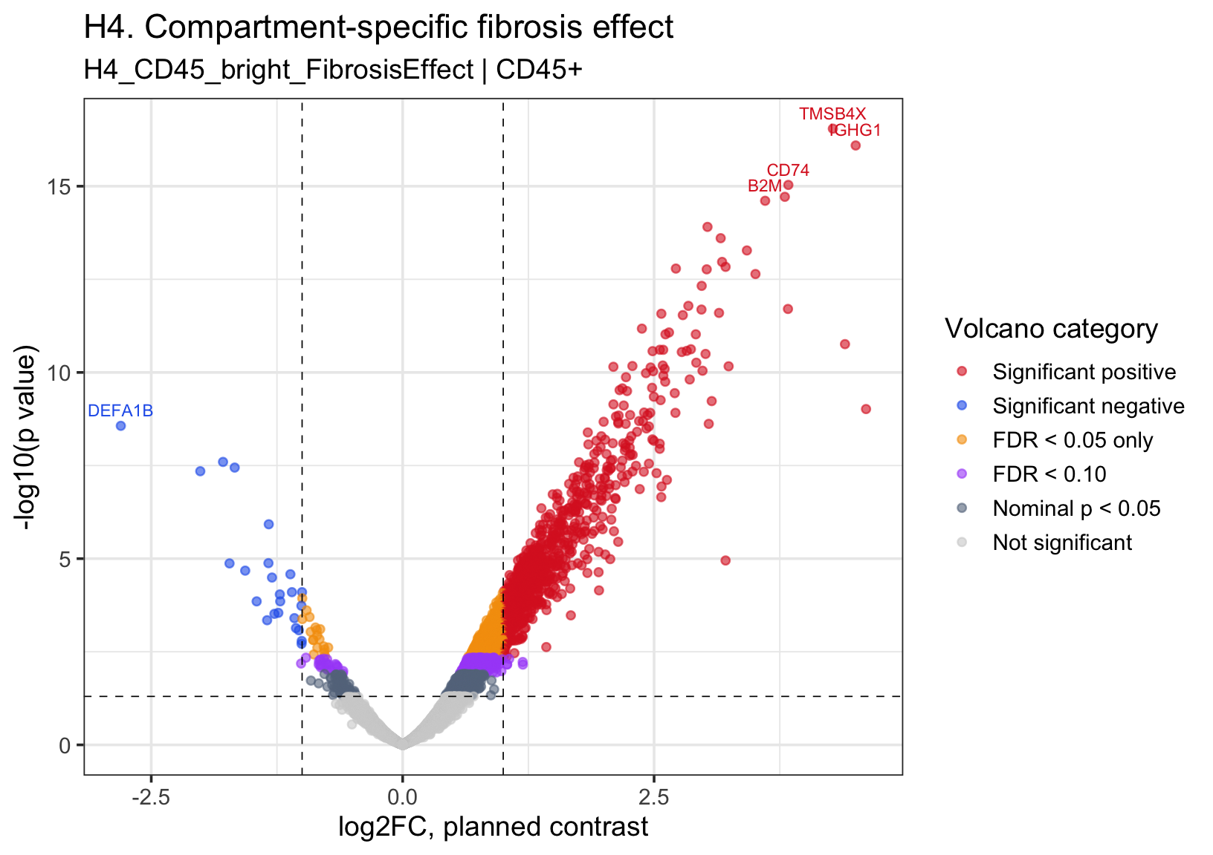
H4: CD45 segment WTA: fibrosis vs non-fibrosis
TableBlock | TargetName | log2FC | ModeratedT | PValue | FDR | Direction | DirectionForTable | VolcanoCategory
Top negative-direction targets | DEFA1B | -2.803 | -7.977 | 2.72e-09 | 7.05e-07 | Higher in Nonfibrotic | Negative contrast direction | Significant negative
Top negative-direction targets | PRTN3 | -1.786 | -7.197 | 2.53e-08 | 4.58e-06 | Higher in Nonfibrotic | Negative contrast direction | Significant negative
Top negative-direction targets | BIVM | -1.670 | -7.077 | 3.59e-08 | 5.88e-06 | Higher in Nonfibrotic | Negative contrast direction | Significant negative
Top negative-direction targets | AZU1 | -2.013 | -7.000 | 4.49e-08 | 6.93e-06 | Higher in Nonfibrotic | Negative contrast direction | Significant negative
Top negative-direction targets | TMTC4 | -1.331 | -5.892 | 1.19e-06 | 1.03e-04 | Higher in Nonfibrotic | Negative contrast direction | Significant negative
Top negative-direction targets | ELANE | -1.335 | -5.089 | 1.32e-05 | 7.04e-04 | Higher in Nonfibrotic | Negative contrast direction | Significant negative
Top negative-direction targets | PTBP1 | -1.722 | -5.083 | 1.34e-05 | 7.09e-04 | Higher in Nonfibrotic | Negative contrast direction | Significant negative
Top negative-direction targets | MPO | -1.566 | -4.934 | 2.10e-05 | 9.84e-04 | Higher in Nonfibrotic | Negative contrast direction | Significant negative
Top negative-direction targets | PRG2 | -1.117 | -4.859 | 2.62e-05 | 1.17e-03 | Higher in Nonfibrotic | Negative contrast direction | Significant negative
Top negative-direction targets | CTSG | -1.299 | -4.790 | 3.22e-05 | 1.36e-03 | Higher in Nonfibrotic | Negative contrast direction | Significant negative
Top positive-direction targets | TMSB4X | 4.278 | 15.860 | 2.85e-17 | 5.33e-13 | Higher in Fibrosis | Positive contrast direction | Significant positive
Top positive-direction targets | IGHG1 | 4.505 | 15.320 | 8.06e-17 | 7.52e-13 | Higher in Fibrosis | Positive contrast direction | Significant positive
Top positive-direction targets | CD74 | 3.835 | 14.100 | 9.24e-16 | 5.75e-12 | Higher in Fibrosis | Positive contrast direction | Significant positive
Top positive-direction targets | TMSB10 | 3.800 | 13.750 | 1.93e-15 | 9.00e-12 | Higher in Fibrosis | Positive contrast direction | Significant positive
Top positive-direction targets | B2M | 3.604 | 13.630 | 2.46e-15 | 9.20e-12 | Higher in Fibrosis | Positive contrast direction | Significant positive
Top positive-direction targets | HLA-B | 3.031 | 12.890 | 1.24e-14 | 3.85e-11 | Higher in Fibrosis | Positive contrast direction | Significant positive
Top positive-direction targets | RPL13 | 3.162 | 12.570 | 2.49e-14 | 6.64e-11 | Higher in Fibrosis | Positive contrast direction | Significant positive
Top positive-direction targets | RPL30 | 3.423 | 12.240 | 5.31e-14 | 1.24e-10 | Higher in Fibrosis | Positive contrast direction | Significant positive
Top positive-direction targets | RPS23 | 3.176 | 11.930 | 1.08e-13 | 2.24e-10 | Higher in Fibrosis | Positive contrast direction | Significant positive
Top positive-direction targets | RPS21 | 3.211 | 11.800 | 1.46e-13 | 2.65e-10 | Higher in Fibrosis | Positive contrast direction | Significant positive

Slide 11
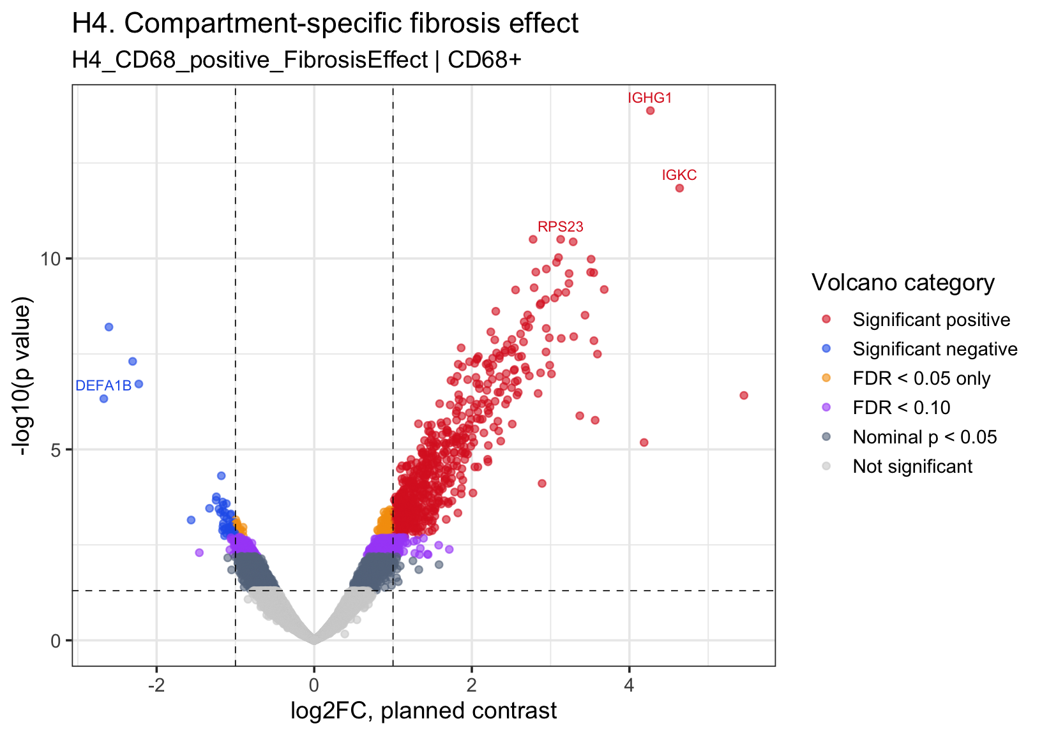
H4: CD68 segment WTA: fibrosis vs non-fibrosis
TableBlock | TargetName | log2FC | ModeratedT | PValue | FDR | Direction | DirectionForTable | VolcanoCategory
Top negative-direction targets | AZU1 | -2.605 | -8.389 | 6.24e-09 | 3.80e-06 | Higher in Nonfibrotic | Negative contrast direction | Significant negative
Top negative-direction targets | ELANE | -2.304 | -7.518 | 4.96e-08 | 1.54e-05 | Higher in Nonfibrotic | Negative contrast direction | Significant negative
Top negative-direction targets | PRTN3 | -2.226 | -6.967 | 1.94e-07 | 3.97e-05 | Higher in Nonfibrotic | Negative contrast direction | Significant negative
Top negative-direction targets | DEFA1B | -2.671 | -6.615 | 4.71e-07 | 8.46e-05 | Higher in Nonfibrotic | Negative contrast direction | Significant negative
Top negative-direction targets | OXGR1 | -1.179 | -4.841 | 4.90e-05 | 3.34e-03 | Higher in Nonfibrotic | Negative contrast direction | Significant negative
Top negative-direction targets | CCDC168 | -1.242 | -4.364 | 1.74e-04 | 8.92e-03 | Higher in Nonfibrotic | Negative contrast direction | Significant negative
Top negative-direction targets | C1QTNF9 | -1.245 | -4.285 | 2.15e-04 | 1.05e-02 | Higher in Nonfibrotic | Negative contrast direction | Significant negative
Top negative-direction targets | GJB2 | -1.163 | -4.246 | 2.38e-04 | 1.13e-02 | Higher in Nonfibrotic | Negative contrast direction | Significant negative
Top negative-direction targets | EEF1AKMT1 | -1.115 | -4.208 | 2.63e-04 | 1.22e-02 | Higher in Nonfibrotic | Negative contrast direction | Significant negative
Top negative-direction targets | OR1J4 | -1.155 | -4.176 | 2.86e-04 | 1.29e-02 | Higher in Nonfibrotic | Negative contrast direction | Significant negative
Top positive-direction targets | IGHG1 | 4.266 | 15.210 | 1.34e-14 | 2.51e-10 | Higher in Fibrosis | Positive contrast direction | Significant positive
Top positive-direction targets | IGKC | 4.637 | 12.450 | 1.44e-12 | 1.34e-08 | Higher in Fibrosis | Positive contrast direction | Significant positive
Top positive-direction targets | RPS23 | 3.127 | 10.830 | 3.15e-11 | 1.37e-07 | Higher in Fibrosis | Positive contrast direction | Significant positive
Top positive-direction targets | LGMN | 2.777 | 10.830 | 3.16e-11 | 1.37e-07 | Higher in Fibrosis | Positive contrast direction | Significant positive
Top positive-direction targets | RPL30 | 3.286 | 10.760 | 3.67e-11 | 1.37e-07 | Higher in Fibrosis | Positive contrast direction | Significant positive
Top positive-direction targets | RPS11 | 3.100 | 10.300 | 9.46e-11 | 2.79e-07 | Higher in Fibrosis | Positive contrast direction | Significant positive
Top positive-direction targets | C1QC | 3.514 | 10.250 | 1.04e-10 | 2.79e-07 | Higher in Fibrosis | Positive contrast direction | Significant positive
Top positive-direction targets | OAZ1 | 3.073 | 10.160 | 1.27e-10 | 2.96e-07 | Higher in Fibrosis | Positive contrast direction | Significant positive
Top positive-direction targets | RPL13 | 2.946 | 9.967 | 1.89e-10 | 3.57e-07 | Higher in Fibrosis | Positive contrast direction | Significant positive
Top positive-direction targets | RPL36A | 2.812 | 9.879 | 2.27e-10 | 3.57e-07 | Higher in Fibrosis | Positive contrast direction | Significant positive

Slide 12
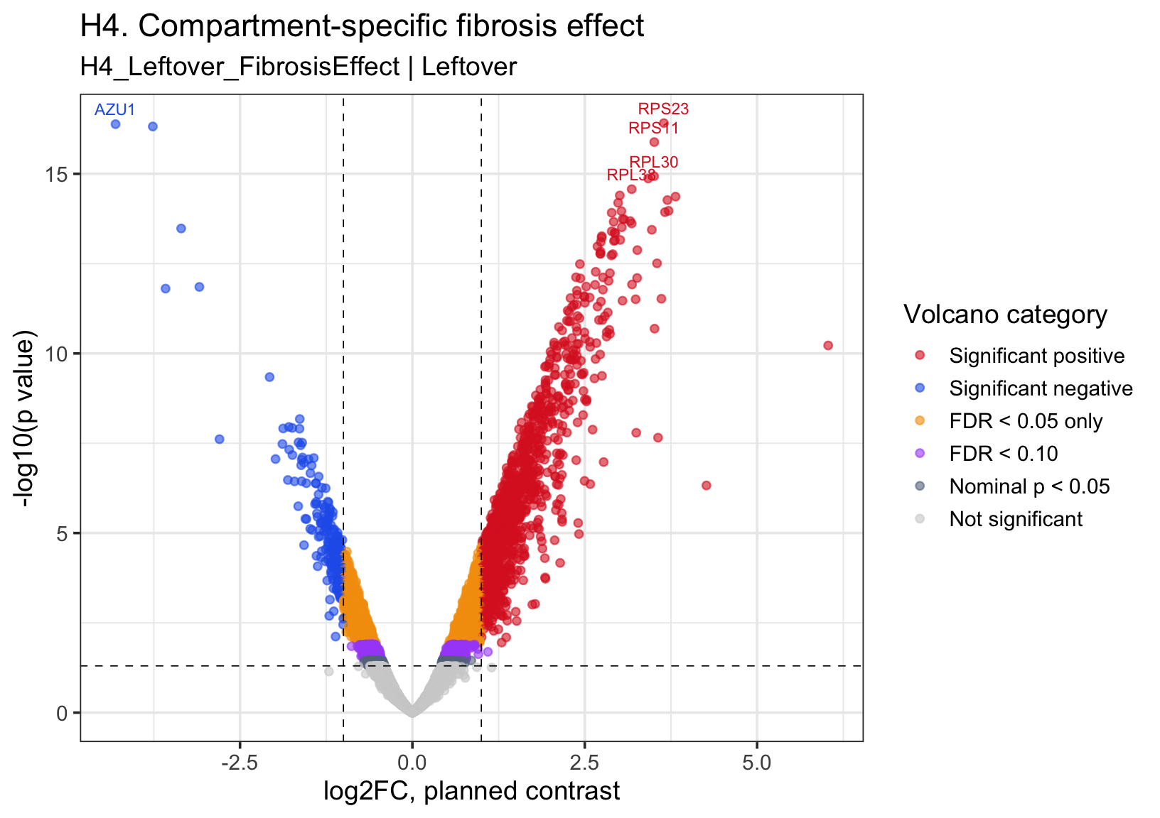
H4: leftover segment WTA: fibrosis vs non-fibrosis
TableBlock | TargetName | log2FC | ModeratedT | PValue | FDR | Direction | DirectionForTable | VolcanoCategory
Top negative-direction targets | AZU1 | -4.305 | -16.910 | 4.14e-17 | 2.99e-13 | Higher in Nonfibrotic | Negative contrast direction | Significant negative
Top negative-direction targets | PRTN3 | -3.765 | -16.820 | 4.81e-17 | 2.99e-13 | Higher in Nonfibrotic | Negative contrast direction | Significant negative
Top negative-direction targets | ELANE | -3.354 | -13.210 | 3.32e-14 | 2.82e-11 | Higher in Nonfibrotic | Negative contrast direction | Significant negative
Top negative-direction targets | CTSG | -3.090 | -11.420 | 1.41e-12 | 5.05e-10 | Higher in Nonfibrotic | Negative contrast direction | Significant negative
Top negative-direction targets | DEFA1B | -3.580 | -11.370 | 1.57e-12 | 5.53e-10 | Higher in Nonfibrotic | Negative contrast direction | Significant negative
Top negative-direction targets | GPR18 | -2.071 | -8.956 | 4.55e-10 | 6.07e-08 | Higher in Nonfibrotic | Negative contrast direction | Significant negative
Top negative-direction targets | ESRRA | -1.634 | -7.911 | 6.70e-09 | 6.02e-07 | Higher in Nonfibrotic | Negative contrast direction | Significant negative
Top negative-direction targets | UBXN11 | -1.792 | -7.720 | 1.11e-08 | 9.19e-07 | Higher in Nonfibrotic | Negative contrast direction | Significant negative
Top negative-direction targets | GPR183 | -1.742 | -7.697 | 1.18e-08 | 9.70e-07 | Higher in Nonfibrotic | Negative contrast direction | Significant negative
Top negative-direction targets | NALCN | -1.874 | -7.684 | 1.23e-08 | 9.99e-07 | Higher in Nonfibrotic | Negative contrast direction | Significant negative
Top positive-direction targets | RPS23 | 3.648 | 16.950 | 3.88e-17 | 2.99e-13 | Higher in Fibrosis | Positive contrast direction | Significant positive
Top positive-direction targets | RPS11 | 3.508 | 16.230 | 1.31e-16 | 6.11e-13 | Higher in Fibrosis | Positive contrast direction | Significant positive
Top positive-direction targets | RPL30 | 3.504 | 14.980 | 1.16e-15 | 4.20e-12 | Higher in Fibrosis | Positive contrast direction | Significant positive
Top positive-direction targets | RPL13 | 3.420 | 14.900 | 1.35e-15 | 4.20e-12 | Higher in Fibrosis | Positive contrast direction | Significant positive
Top positive-direction targets | RPL38 | 3.181 | 14.520 | 2.68e-15 | 7.15e-12 | Higher in Fibrosis | Positive contrast direction | Significant positive
Top positive-direction targets | RPS21 | 3.008 | 14.310 | 4.00e-15 | 8.94e-12 | Higher in Fibrosis | Positive contrast direction | Significant positive
Top positive-direction targets | RPL37A | 3.816 | 14.270 | 4.31e-15 | 8.94e-12 | Higher in Fibrosis | Positive contrast direction | Significant positive
Top positive-direction targets | IGHG1 | 3.698 | 14.150 | 5.38e-15 | 1.00e-11 | Higher in Fibrosis | Positive contrast direction | Significant positive
Top positive-direction targets | RPS8 | 2.984 | 14.060 | 6.42e-15 | 1.09e-11 | Higher in Fibrosis | Positive contrast direction | Significant positive
Top positive-direction targets | RACK1 | 3.716 | 13.790 | 1.07e-14 | 1.51e-11 | Higher in Fibrosis | Positive contrast direction | Significant positive

Slide 13
AML-TP53 fibrosis DSP
H2：Region main effect = PARA vs INT
H2a. Region composition effect
H2b. Region expression-state effect
PARA vs INT 是否有不同 compartment abundance？
例如：paratrabecular 是否有更多 CD68+ area？
這是 composition analysis，不是 expression DE。
在同一個 compartment 內，PARA vs INT 是否有 expression difference？
CD45-bright / CD68+ / Leftover 分開做。
0.5×(F_PARA − F_INT) + 0.5×(NF_PARA − NF_INT)
H2 是 H3 的前置理解：若 H2 不強但 H3 強，代表 region difference 可能只在 fibrosis context 下出現。
07

Slide 14
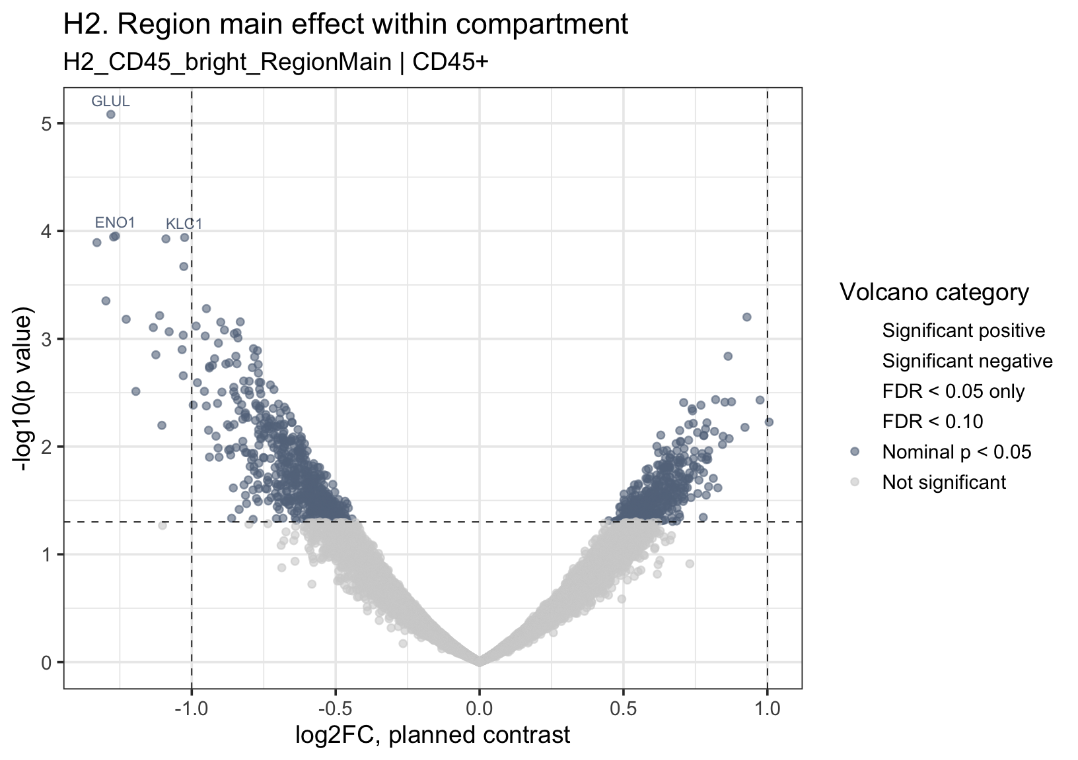
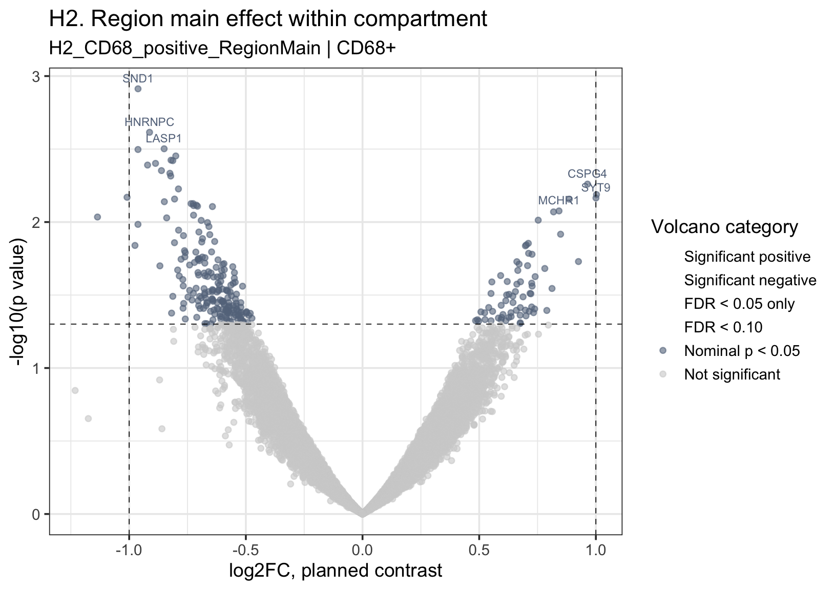
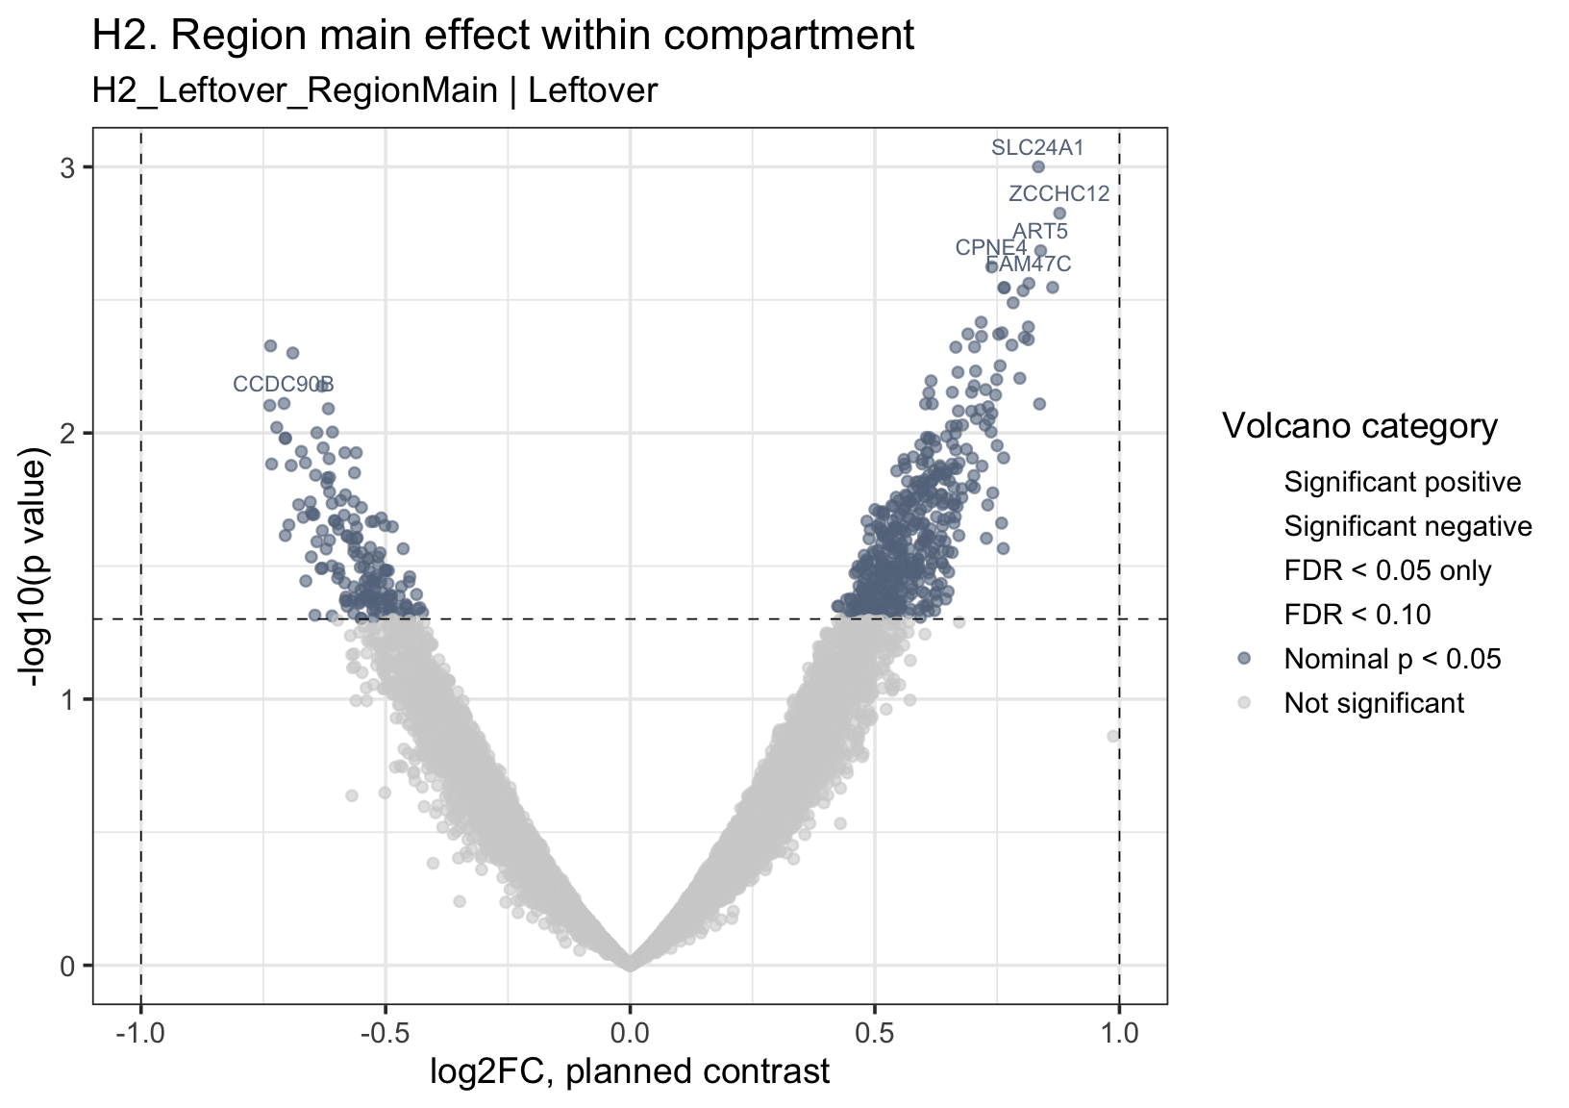
H2: no difference between paratrabecular region vs intertrabecular region

Slide 15
AML-TP53 fibrosis DSP
H3：Fibrosis-specific paratrabecular niche effect
Nonfibrotic
Fibrosis
核心問題
INT
NF_INT
F_INT
Fibrosis-associated transcriptomic change 是否特別集中或放大在 paratrabecular region？
PARA
NF_PARA
F_PARA
Parameter handling
FibrosisGroup：interaction factor。
Region：interaction factor。
SegmentLabel：分 compartment 分析。
Case/AOI：pilot descriptive interaction DE；正式 inference 需要更多 cases。
(F_PARA − F_INT) − (NF_PARA − NF_INT)
這是 FibrosisGroup × Region interaction，也是本設計最核心的 DSP contrast。
08

Slide 16
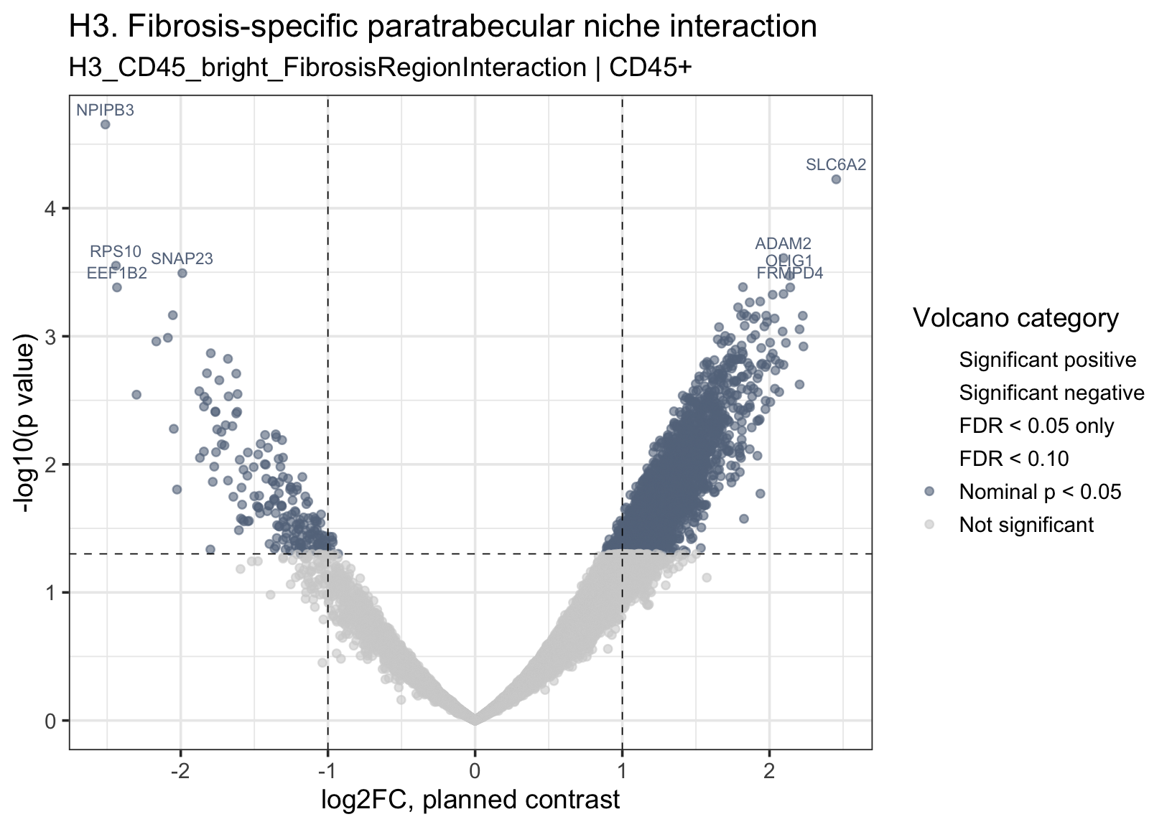
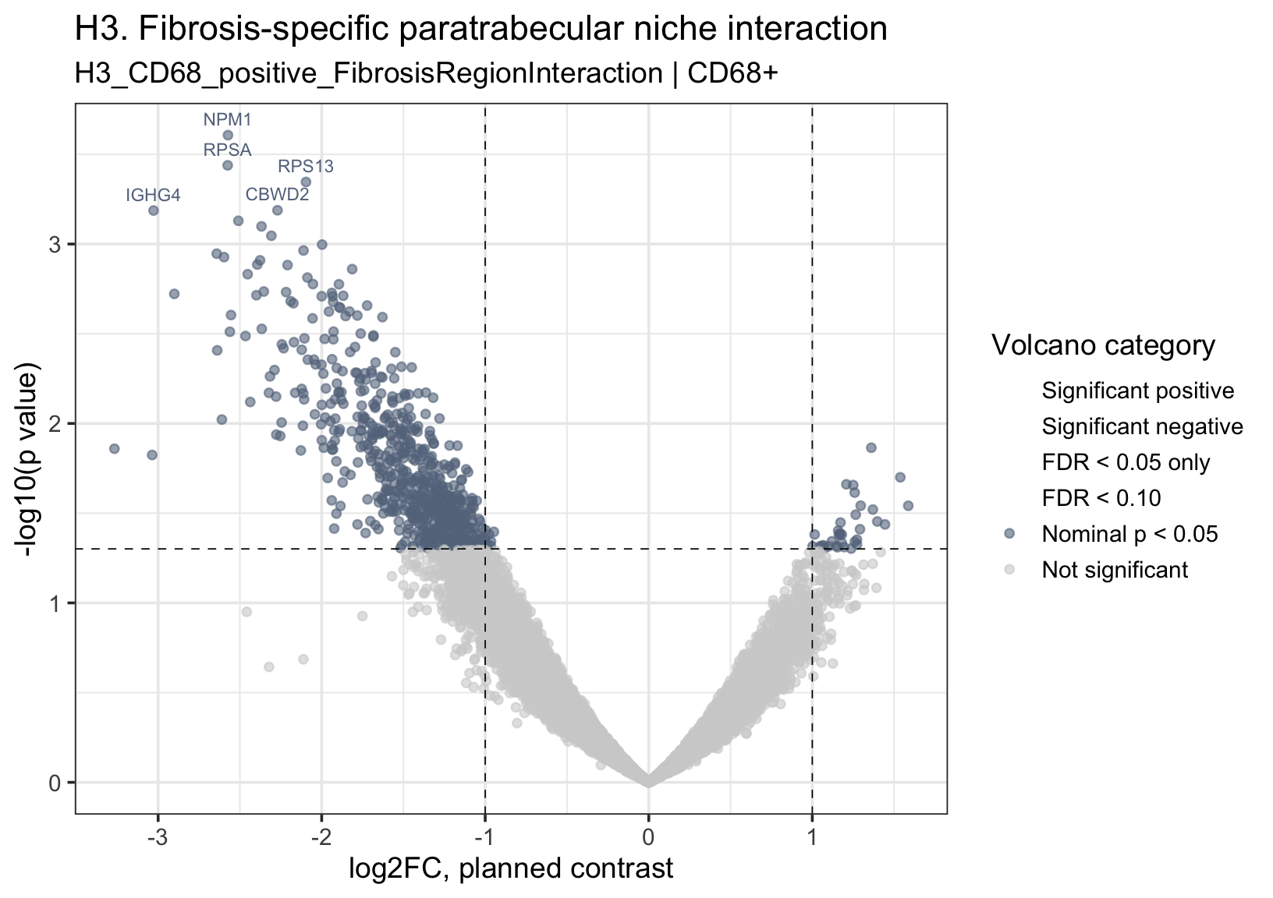
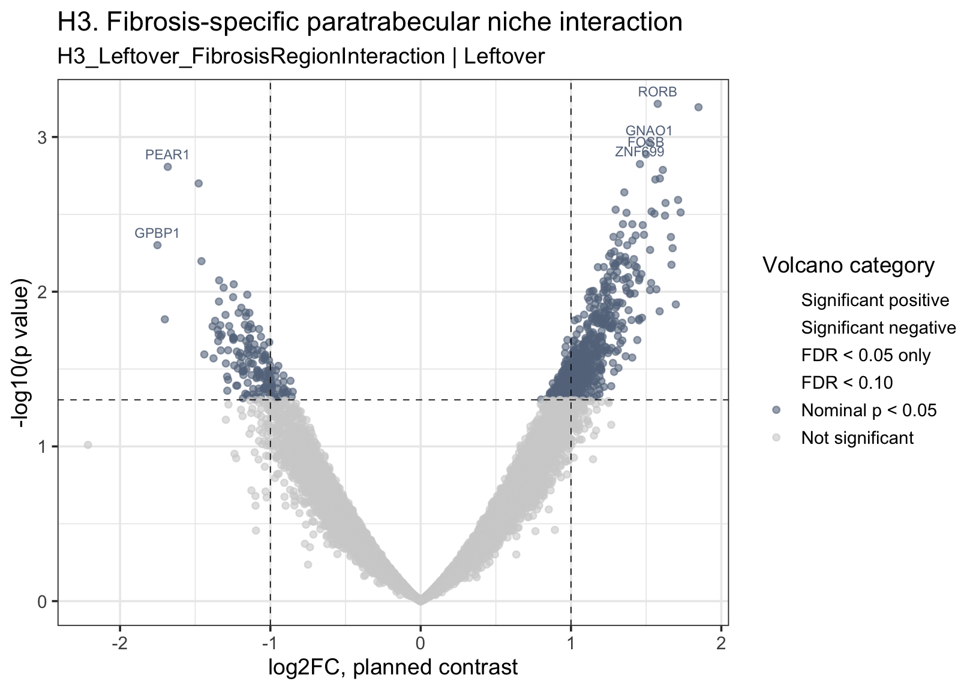
H3: no difference between fibrosis x region interaction

Slide 17
Summary:
Positive findings
(H1) fibrosis vs nonfibrosis shows a lot of effect, but case level difference cannot be excluded
(H4) The effects are present in different segments
Negative findings
(H2, H3) Region difference and region interaction difference shows no difference in current datasets
Next Step:
放棄?
因為少量case測試，未見regional (inter vs para) effect
若仍認為有spatial effect, 可能DSP resolutio太低？是否改為spatial transcriptome in single cell resolution
不放棄？
再加更多case, 直到一定比例 (如3 vs 3, or 6 vs 6, …)

Slide 18
AML-TP53 fibrosis DSP
Nested design 與目前資料的統計定位
標準上需要考慮
目前 pilot 限制
同一 case 內有多個 AOI / region / segment，不能把所有 observations 視為完全獨立 biological cases。
Primary set：Fibrosis A1/A2；Nonfibrotic B1。
Nonfibrotic 只有一個 case，mixed model / case random effect 會不穩。
本輪分析定位
溝通重點
用 AOI-level limma planned contrasts 產生 DE / ranked list。
P value / FDR：descriptive, hypothesis-generating。
可加 case-collapsed effect-size sanity check。
現在的目標是確認 signal direction、模型可行性、是否值得加 case；不是宣稱完成 case-level definitive inference。
嚴謹版本需要更多 cases (at least 3 vs 3)：才能把 case-level correlation 放進模型並支持正式統計推論。
09

Slide 19
AML-TP53 fibrosis DSP
Planned contrasts → DE / ranked list → downstream
Hypothesis
H0–H4
Model / contrast
planned coefficient
DE table
log2FC, p, FDR, t
Ranked list
per contrast
GSEA / ORA
predefined sets
Downstream 的標準原則
預設 gene set 方向
GSEA / ORA 要接在正確的 coefficient 後面：
• H3 interaction：用 interaction ranked list。
• H4 compartment fibrosis：用各 compartment 的 fibrosis effect ranked list。
• 不用看結果後再換 gene set。
優先使用外部 predefined collections：
Reactome ECM organization、collagen formation、NABA matrisome、Hallmark TGF-beta。
Fibrosis genes 不手刻。
10

